Slide 1
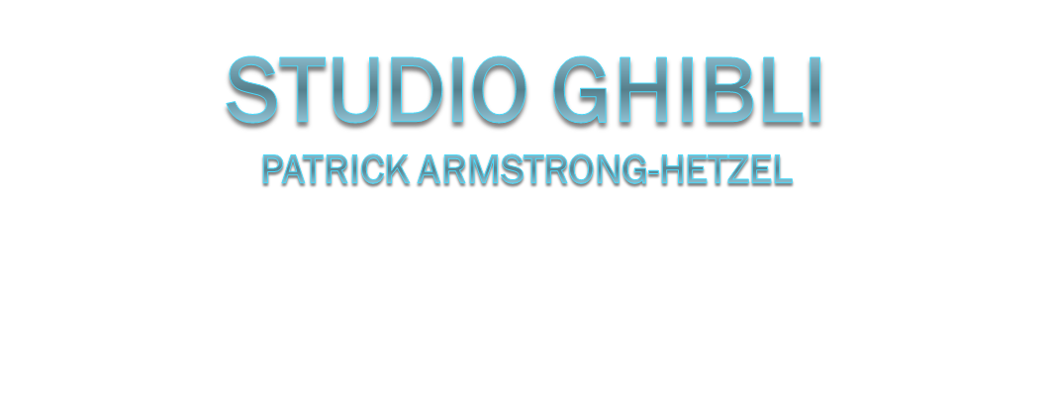

Slide 2
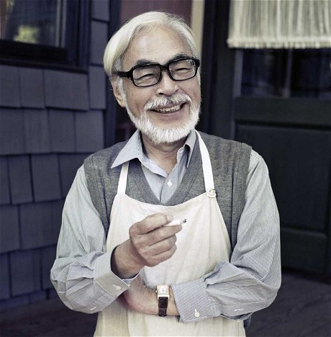
Hayao Miyazaki
Hayao Miyazaki, born January 5, 1941, is a Japanese film director, producer, screenwriter, animator, author, and manga artist. Through a career that has spanned five decades, Miyazaki has attained international acclaim as a masterful storyteller and as a maker of anime feature films and, along with Isao Takahata, co-founded Studio Ghibli, a film and animation studio.

Slide 3
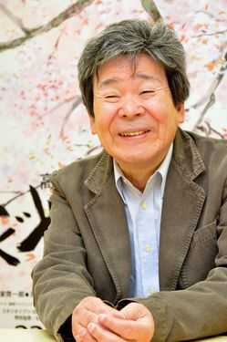
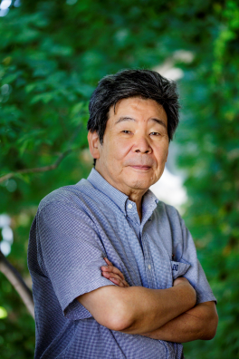
Isao Takahata
Isao Takahata, born October 29, 1935, is a Japanese film director, animator, screenwriter and producer who has earned critical international acclaim for his work as a director of anime films. Takahata is the co-founder of Studio Ghibli along with long-time collaborative partner Hayao Miyazaki. Takahata's most recent film is The Tale of the Princess Kaguya, which was nominated for an Academy Award in the category Best Animated Feature Film at the 87th Academy Awards. Takahata does not draw and had not worked as an animator before he became a director.

Slide 4
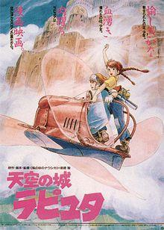
Laputa: Castle in the Sky
Laputa: Castle in the Sky is a 1986 Japanese animated adventure film written and directed by Hayao Miyazaki and is also the first film produced and released by Studio Ghibli. Laputa: Castle in the Sky won the Animage Anime Grand Prix in 1986. In the film's backstory, human civilizations built flying cities, which were later destroyed by an unspecified catastrophe, forcing the survivors to live on the ground. The only remaining flying city, Laputa, still floats in the sky, concealed by a permanent powerful hurricane that surrounds it.

Slide 5
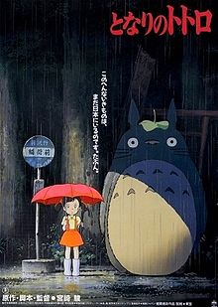
My Neighbour Totoro
My Neighbour is a 1988 Japanese animated fantasy film written and directed by Hayao Miyazaki and produced by Studio Ghibli. The film tells the story of the two young daughters (Satsuki and Mei), of a professor and their interactions with friendly wood spirits in post-war rural Japan. The film won the Animage Anime Grand Prix prize and the Mainichi Film Award and Kinema Junpo Award for Best Film in 1988. It also received the Special Award at the Blue Ribbon Awards in the same year.

Slide 6
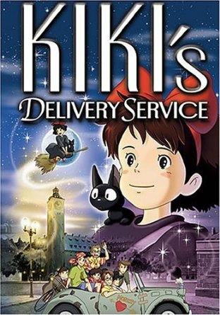
Kiki’s Delivery Service
Kiki's Delivery is a 1989 Japanese animated fantasy film produced by Studio Ghibli. It was written, produced and directed by Hayao Miyazaki as an adaptation of the 1985 novel of the same name by Eiko Kadono. The film tells the story of a young witch, Kiki, who moves to a new town and uses her flying ability to earn a living. According to Miyazaki, the movie portrays the gulf between independence and reliance in teenage Japanese girls. Kiki's Delivery Service was released in Japan on July 29, 1989, and won the Animage Anime Grand Prix prize. It was the first Studio Ghibli film released under the 15 year distribution partnership between The Walt Disney Company and Studio Ghibli.

Slide 7
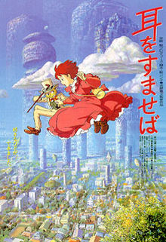
Whisper of the Heart
Whisper of the Heart is a 1995 Japanese animated romantic drama film directed by Yoshifumi Kondō and written by Hayao Miyazaki based on the 1989 manga of the same name by Aoi Hiiragi. It was the first theatrical Studio Ghibli film to be directed by someone other than Miyazaki or Isao Takahata. Whisper of the Heart was Kondō's only film as director before his death in 1998. Studio Ghibli had hoped that Kondō would become the successor to Miyazaki and Takahata.

Slide 8
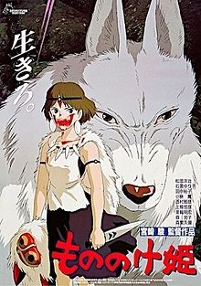
Princess Mononoke
Princess Mononoke is a 1997 Japanese historical fantasy anime film, written and directed by Hayao Miyazaki. It was animated by Studio Ghibli and produced by Toshio Suzuki. The film is set in the late Muromachi period (1336 to 1573) of Japan with fantasy elements. The story follows the young warrior Ashitaka's involvement in a struggle between forest gods and the humans who consume its resources. The term “Mononoke” is not a name, but a Japanese word for a spirit or monster. Unlike Ghibli's earlier films, Mononoke has a darker and more violent setting and tone.

Slide 9
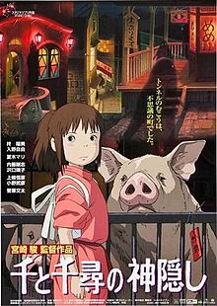
Spirited Away
Spirited Away is a 2001 Japanese anime fantasy film written and directed by Hayao Miyazaki and produced by Studio Ghibli. The film tells the story of Chihiro Ogino, a ten year old girl who, while moving to a new neighbourhood, enters the spirit world. After her parents are transformed into pigs by the witch Yubaba, Chihiro takes a job working in Yubaba's bathhouse to find a way to free herself and her parents and return to the human world.

Slide 10
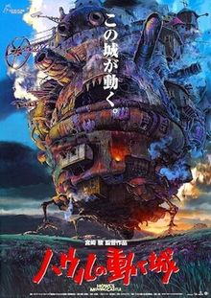
Howl’s Moving Castle
Howl's Moving Castle is a 2004 Japanese animated fantasy film scripted and directed by Hayao Miyazaki. The film is based on the novel of the same name by British writer Diana Wynne Jones. The film was produced by Toshio Suzuki, animated by Studio Ghibli and distributed by Toho. The story is set in a fictional kingdom where both magic and 19th century technology are prevalent, against the backdrop of a war with another kingdom. The film tells the story of a young hatter named Sophie after she is turned into an old woman by a witch's curse. She encounters a wizard named Howl, and gets caught up in his resistance to fighting for the king.

Slide 11
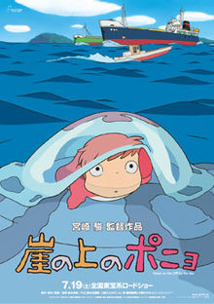
Ponyo
Ponyo, initially titled in English as Ponyo on the Cliff by the Sea, is a 2008 Japanese animated fantasy film written and directed by Hayao Miyazaki and produced by Studio Ghibli. The plot centres on a goldfish named Ponyo who befriends a five-year-old human boy, Sōsuke, and wants to become a human girl.

Slide 12
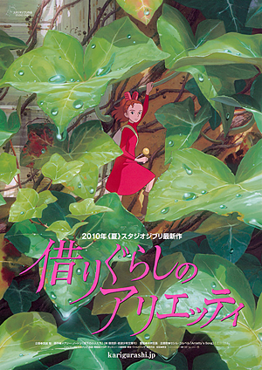
Arrietty
Arrietty, titled The Borrower Arrietty in Japan and The Secret World of Arrietty in North America, is a 2010 Japanese animated fantasy film made in Studio Ghibli, directed by Hiromasa Yonebayashi and scripted by Hayao Miyazaki and Keiko Niwa. It is based on The Borrowers by Mary Norton, an English author of children's books, about a family of tiny people who live secretly in the walls and floors of a typical household, borrowing items from humans to survive. The film tells the story of a young Borrower (Shida) befriending a human boy (Kamiki), while trying to avoid being detected by the other humans. Toshio Suzuki produced the film

Slide 13
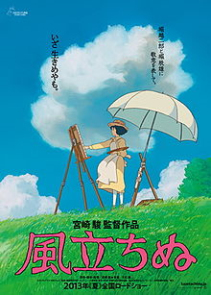
The Wind Rises
The Wind Rises is a Japanese animated historical drama film written and directed by Hayao Miyazaki and animated by Studio Ghibli. It was released by Toho on July 20, 2013 in Japan, and by Touchstone Pictures in North America on February 21, 2014. The Wind Rises is a fictionalized biopic of Jiro Horikoshi (1903–1982), designer of fighter aircraft used by the Empire of Japan during World War II. The film is adapted from Miyazaki's manga of the same name, which was in turn loosely based on the 1937 short story The Wind Has Risen, by Tatsuo Hori. It was the final film directed by Miyazaki before his retirement in September 2013. The Wind Rises was the highest-grossing Japanese film in Japan in 2013 and received widespread critical acclaim. It won and was nominated for several awards, including nominations for the Academy Award for Best Animated Feature, the Golden Globe Award for Best Foreign Language Film, and the Japan Academy Prize for Animation of the Year.

Slide 14
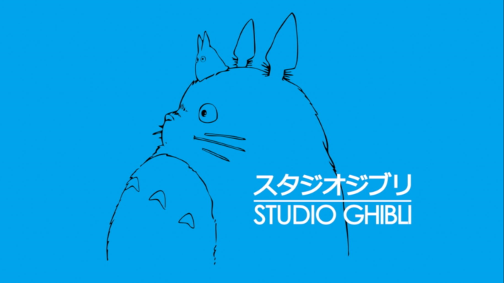
Studio Ghibli
Studio Ghibli is a Japanese animation film studio based in Koganei, Tokyo, Japan. The studio is best known for its anime feature films, and has also produced several short films, television commercials, and one television film. Eight of Studio Ghibli's films are among the 15 highest-grossing anime films made in Japan, with Spirited Away (2001) being the highest, grossing over US$290 million worldwide. Many of their works have won the Animage Anime Grand Prix award, and four have won the Japan Academy Prize for Animation of the Year. Five of Studio Ghibli's films received Academy Award nominations in the United States. Spirited Away won a Golden Bear in 2002 and an Academy Award for Best Animated Feature Film in 2003.

Slide 15
Bibliography
https://en.wikipedia.org/wiki/Castle_in_the_Sky
https://en.wikipedia.org/wiki/Spirited_Away
https://en.wikipedia.org/wiki/My_Neighbor_Totoro
https://en.wikipedia.org/wiki/Princess_Mononoke
https://en.wikipedia.org/wiki/Howl%27s_Moving_Castle_(film)
https://en.wikipedia.org/wiki/Ponyo
https://en.wikipedia.org/wiki/The_Wind_Rises
https://en.wikipedia.org/wiki/Isao_Takahata
https://en.wikipedia.org/wiki/Studio_Ghibli
https://en.wikipedia.org/wiki/Hayao_Miyazaki
https://en.wikipedia.org/wiki/Kiki%27s_Delivery_Service
https://en.wikipedia.org/wiki/Arrietty
https://en.wikipedia.org/wiki/Whisper_of_the_Heart

